Slide 1
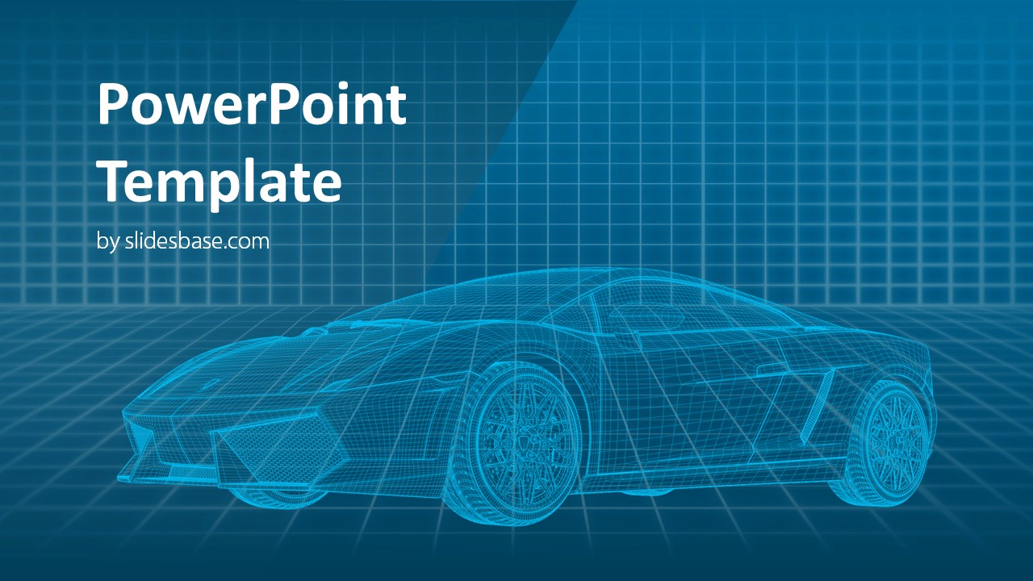

Car Price Prediction

Slide 2



Contents
Business understanding
Descriptive Analysis
Prediction Model
Car Price Prediction
Problem statement
KPI definition
Exploratory data
analysis
Data preprocessing
Key Findings
Model Building
Prediction for price
Notes:
Problem statement
KPIs in your dataset
Key findings
Inferences

Slide 3
Business Understanding
02
01
Toyota Motor Corporation is a Japanese multinational automotive manufacturer.
Since 2012, Toyota had produced more than 10 million vehicles per year.
Toyota is the world's market leader in sales of vehicles also
Background
Production of Cars & Sales of Cars are key revenue generators of the company.
The Objective is to find the Price at which cars should be sold to yield maximum profit to the company
Problem
Statement
02
Profit
Deliver a Product Pricing model – Right Product at Right Price
KPI
Definition

Slide 4


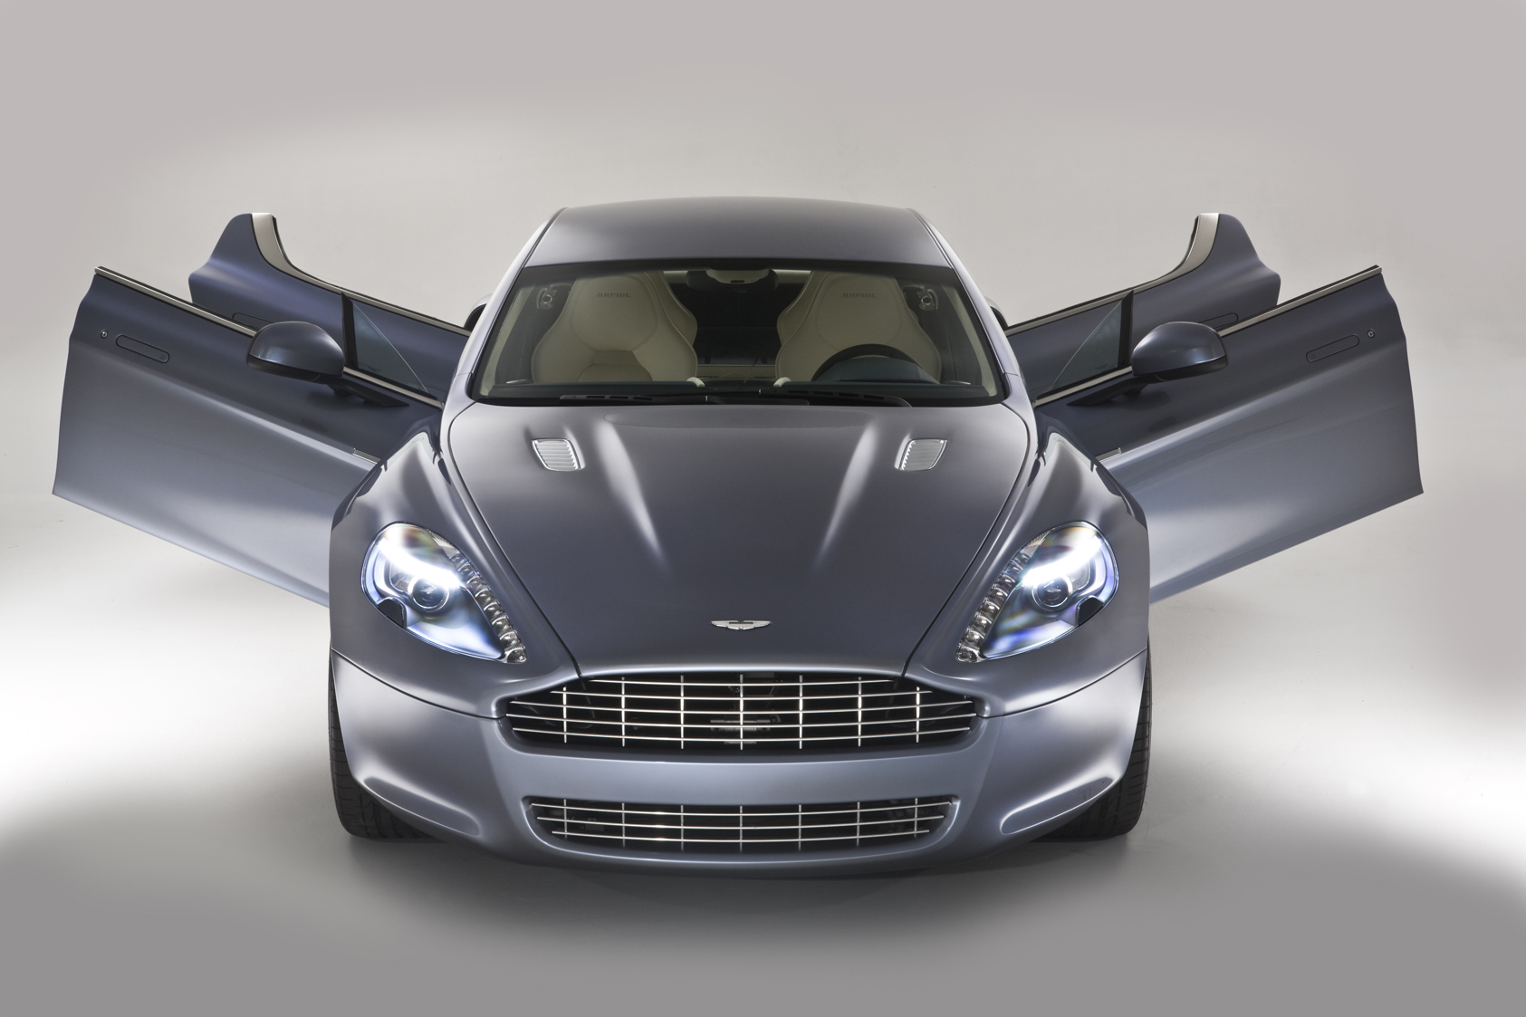

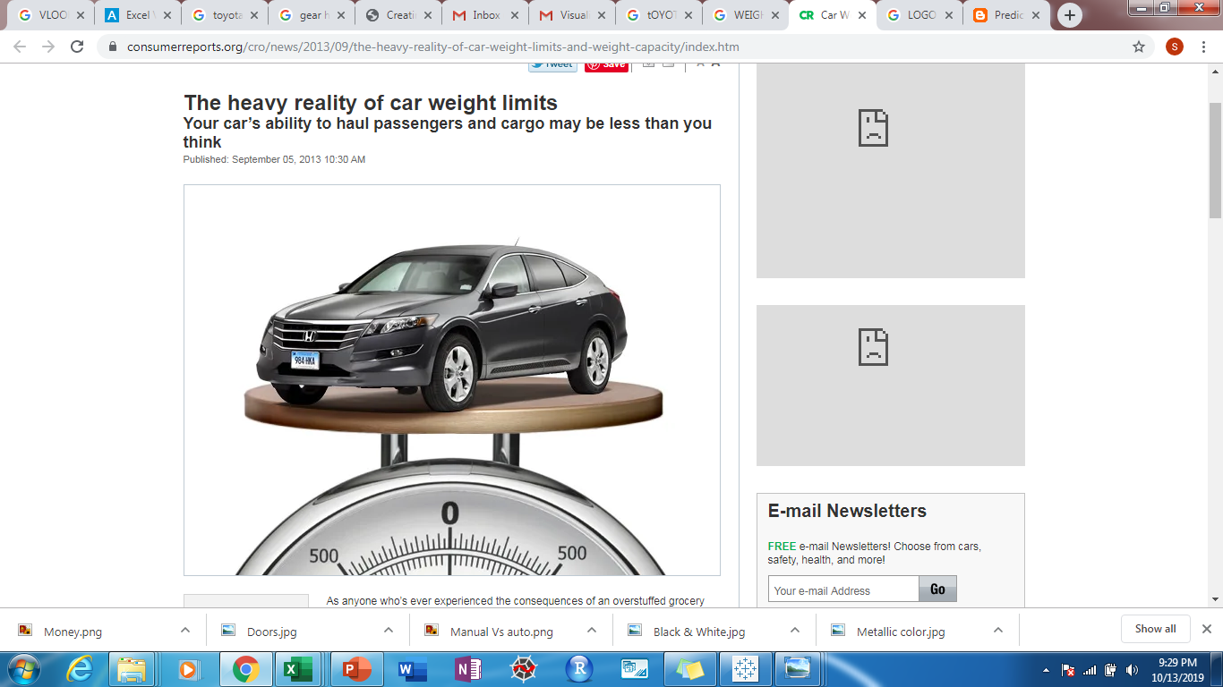
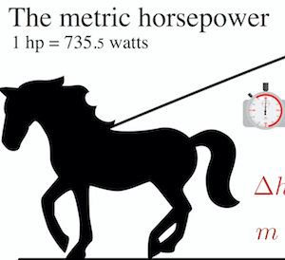


Descriptive Analysis
Age
Automatic
Months
(1-80)
Gear box mode
(Auto,Manual)
6
1
CC
Kilometers
Driven
Cubic centimeters
(1300-2000)
7
Kms
(1-243000)
Doors
2
Fuel Type
(2,3,4,5)
(Diesel ,Petrol,CNG)
8
3
Weight
Horse Power
Kg
(1000-1615)
HP
(69-192)
9
Metallic
Color
Price
4
Dollars
(4350-32500)
Black & White
10
5

Slide 5



Data Preprocessing
Special character
HP = Mean
Special Character(??)
KMs = Median
Missing Values
Fuel Type = Mode
Missing Value
Age =Mean
Blank
Metallic
Color = Mode
Categorical Variable
Fuel Type = Encoding
String
Doors = Type Conversion
Cleaned Data Analysis
Model Accuracy

Slide 6

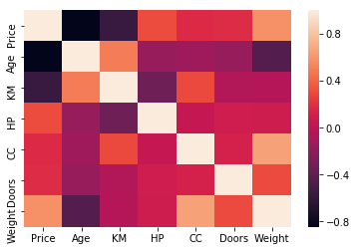
Positive Relationships
Negative Relationships
Correlation Matrix
Relationships
Weight
Horse Power
CC
Doors
All Quantitative variables were analyzed with Price to determine the relationship
^{Age}
^{Kilometers}
i
ii
iii
Age of the Car is a strong influencer of price
Weight of Car increases Price increases
Kilometers driven influences price negatively

Slide 7
Multiple Linear Regression
Prediction Model
Dependent Variable
Price
Independent Variable
10 Variables
Predicted Model
Model Evaluation
Score = 88
R-squared: 0.983
Adj. R-squared: 0.982

